Slide 1
Robust Estimator for Location Parameters
Jake Hamlin, Rebin Kawani, Thiago Cabral, Vicky Bergquist

Slide 2
Outline
Introduction
Problem of interest and notation
Monte Carlo Simulation
Models/approaches and criteria of comparison
Results/Discussions
Graphs/tables
Conclusion

Slide 3
Objective of the Presentation
We are interested in the performance (bias, Variance and mean square error) of some robust estimators under different sets of conditions of interest.
Notes:
- Suppose there is a fixed parameter that needs to be estimated. Then an "estimator" is a function that maps the sample space to a set of sample estimates
- The sample average and the sample standard deviation are the classical estimators of the location and scale parameter of a statistical distribution.
- They are however unreliable in presence of outliers.
- It is important to realize that the statistical efficiency of an estimator depends on the For instance, the sample average has the optimal efficiency of 100% at the normal distribution, but at other distributions its efficiency may become very low.
- The CAPABILITY procedure provides several methods for computing robust estimates of location and
scale, which are insensitive to outliers in the data.

Slide 4
Types of Estimators
Classical Estimators
What is it?
Weakness
Robust Estimators
What is it?
Benefits
Notes:
- Suppose there is a fixed parameter that needs to be estimated. Then an "estimator" is a function that maps the sample space to a set of sample estimates
- The sample average and the sample standard deviation are the classical estimators of the location and scale parameter of a statistical distribution.
- They are however unreliable in presence of outliers.
- It is important to realize that the statistical efficiency of an estimator depends on the For instance, the sample average has the optimal efficiency of 100% at the normal distribution, but at other distributions its efficiency may become very low.
- The CAPABILITY procedure provides several methods for computing robust estimates of location and
scale, which are insensitive to outliers in the data.

Slide 5
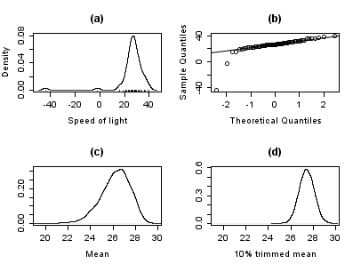
Example

Slide 6

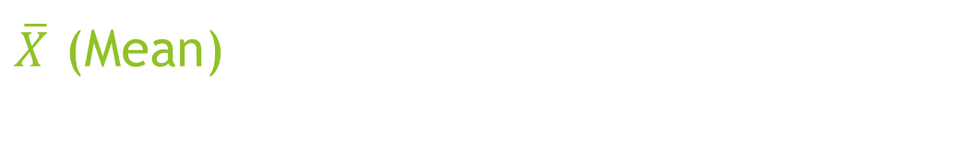
$\overline{X}$ (Mean)
$\overline{X}$ $=\frac{1}{n}\sum_{i=1}^{n}{X_{i}}$
Y= {92,19,101,58,1053,91,26,78,10,13,-40,101,86,85,15,89,89,28,-5,41}
Sample size (N) = 20
$\overline{X}$ = 101.5
Notes:
The k-times trimmed mean is a robust estimator of location which is computed as below where n is the number of observations, and x(r) is the rth order statistic when the observations are arranged in increasing order:
The trimmed mean is the mean computed after the r smallest observations and the r largest observations in
the sample are deleted.
For data from a symmetric distribution, the trimmed mean is an unbiased estimate of the population mean.
However, the trimmed mean does not have a normal distribution even if the data are normally distributed.

Slide 7

Alternate Estimators of µ (mean)
r – Trimmed mean ${( T}_{rn })$
r – Winsorized mean $( W_{rn })$
r – Linearly weighted mean $( L_{rn })$
Median $( M)$
Notes:
When outliers are present in the data, trimmed and Winsorized means are robust estimators of the population mean that are relatively insensitive to the outlying values. Therefore, trimming and Winsorization are methods for reducing the effects of extreme values in the sample
A couple of ways to determine whether there are outliers in the model are the Grubbs’ Outlier Test, and the Dixon Outlier Test.

Slide 8


r – Trimmed Mean ${(T}_{rn })$
$T_{r}=\frac{X_{r+1:n}+X_{r+2:n}+…+X_{n−r:n}}{n−2r}$
r = 10%
Yordered= {-40,-5,10,13,15,19,26,28,41,58,78,85,86,89,89,91,92,101,101,1053}
Ytrimmed= {10,13,15,19,26,28,41,58,78,85,86,89,89,91,92,101}
$T_{rn }$= 57.56 N =16
Notes:
The k-times trimmed mean is a robust estimator of location which is computed as below where n is the number of observations, and x(r) is the rth order statistic when the observations are arranged in increasing order:
The trimmed mean is the mean computed after the r smallest observations and the r largest observations in
the sample are deleted.
For data from a symmetric distribution, the trimmed mean is an unbiased estimate of the population mean.
However, the trimmed mean does not have a normal distribution even if the data are normally distributed.

Slide 9


r – Winsorized Mean ${(W}_{rn })$
$W_{r}=\frac{(r+1)X_{r+1:n}+X_{r+2:n}+…+X_{n−r−1:n}{+(r+1)X}_{n−r:n}}{n}$
r = 10%
Y= {92,19,101,58,1053,91,26,78,10,13,-40,101,86,85,15,89,89,28,-5,41}
Yordered= {-40,-5,10,13,15,19,26,28,41,58,78,85,86,89,89,91,92,101,101,1053}
Ywindsorized = {92,19,101,58,101,91,26,78,10,13,-5,101,86,85,15,89,89,28,-5,41}
$W_{rn }$= 55.65 N=20
Notes:
The k-times trimmed mean is a robust estimator of location which is computed as below where n is the number of observations, and x(r) is the rth order statistic when the observations are arranged in increasing order:
The trimmed mean is the mean computed after the r smallest observations and the r largest observations in
the sample are deleted.
For data from a symmetric distribution, the trimmed mean is an unbiased estimate of the population mean.
However, the trimmed mean does not have a normal distribution even if the data are normally distributed.

Slide 10

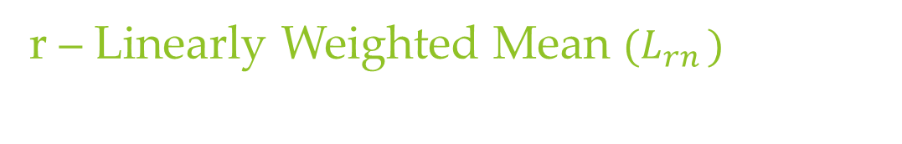
r – Linearly Weighted Mean ${(L}_{rn })$
$$L_{r}=\frac{1}{{2(\frac{n}{2} −r)}^{2} }\sum_{i=1}^{\left[\frac{n}{2}\right]−r}{(2i−1)(}X_{r+i:n}+X_{n−r−i+1:n})$$
r = 10%
Yordered= {-40,-5,10,13,15,19,26,28,41,58,78,85,86,89,89,91,92,101,101,1053}
$$L_{r}=\frac{1}{{2(\frac{20}{2} −2)}^{2} }\sum_{i=1}^{8}{(2i−1)(}X_{r+i:n}+X_{n−r−i+1:n})$$
$L_{r}=0.007813∗\left({ 1∗(X}_{3}+X_{18}\right)+3∗{(X}_{4}+X_{17})+ …+ { 15∗(X}_{10}+X_{11})$
$L_{rn}=59.99$
Notes:
3) r – linearly weighted mean

Slide 11


Median$(M)$
M$=\left\{\begin{aligned}X_{\frac{n+1}{2}:n} if n is odd \\ &\frac{1}{2}\left[X_{\frac{n}{2}:n}+X_{\frac{n}{2}+1:n}\right] if n is even\end{aligned}\right.$
N= 20
Yordered= {-40,-5,10,13,15,19,26,28,41,58,78,85,86,89,89,91,92,101,101,1053}
M = $\frac{1}{2}\left[X_{10}+X_{10+1}\right]$ = $\frac{1}{2}\left[58+78\right]$
M = 68

Slide 12
Monte Carlo Simulation
Simulation: A numerical technique for conducting experiments on the computer.
Monte Carlo simulation: Computer experiment involving random sampling from probability distributions
Invaluable in statistics. . .
Usually, when statisticians talk about “simulations,” they mean “Monte Carlo simulations”.

Slide 13
Monte Carlo Simulation
How to approximate: A typical Monte Carlo simulation involves the following
Generate S independent data sets under the conditions of interest
Compute the numerical value of the estimator T(data) for each data set ) T1,…,TS
If S is large enough, summary statistics across T1,…,TS should be good approximations to the true sampling properties of the estimator under the conditions of interest

Slide 14
Monte Carlo Simulation
Simulation Procedure:
Step 1: Fix n and the model to be used. Set μ =0
Step 2: Generate independent draws X₁,X₂,…X_{n} from the fixed model
Step 3: Compute the estimators of interest
Step 4: Repeat steps 1,2,and 3, k times
Step 5 :Compute the mean/var/mse of the estimators
Obs: repeat steps 1 to 5 with different sample sizes(n)

Slide 15

Monte Carlo Simulation
Robust estimators of interest
$$\overline{X,}T_{0.1n},T_{0.2n},W_{0.1n},W_{0.2n},L_{0.1n},L_{0.2n},M_{}$$

Slide 16
Monte Carlo Simulation
Fixed Models
Normal (0,1)
Random outlier model: 0.9 N(0,1) + 0.1 N(0,4)
Random outlier model: 0.8 N(0,1) + 0.2 N(0,4)
Fixed outlier model: (n-1) N(0,1) and 1N(0,4)
Fixed outlier model: (n-2) N(0,1) and 2N(0,4)

Slide 17
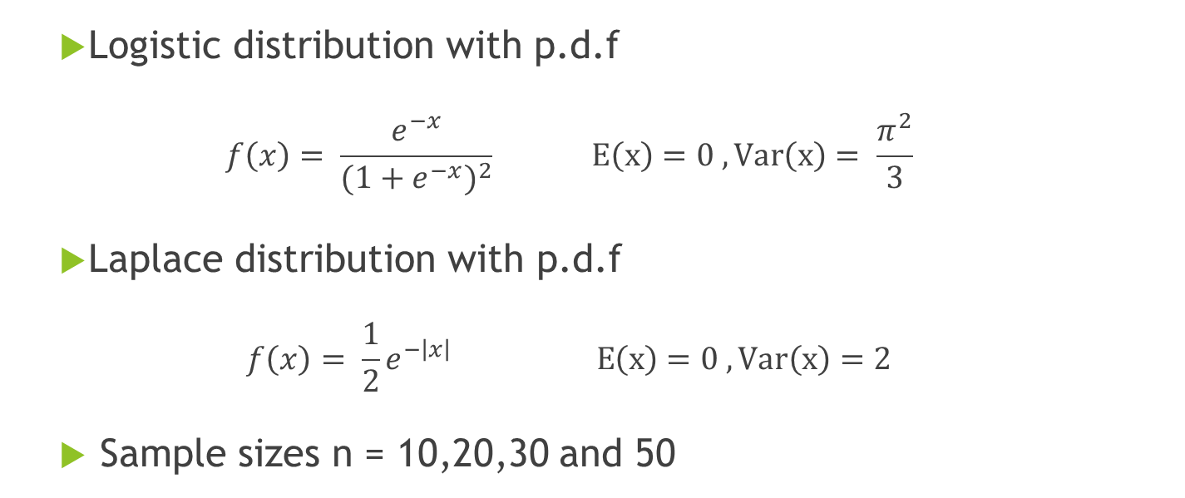
Monte Carlo Simulation
Logistic distribution with p.d.f
$$f\left(x\right)= \frac{e^{−x}}{{(1+e^{−x})}^{2}} E\left(x\right)=0 , Var\left(x\right)= \frac{π^{2}}{3}$$
Laplace distribution with p.d.f
$$f\left(x\right)= \frac{1}{2}e^{−\left|x\right|} E\left(x\right)=0 , Var\left(x\right)=2$$
Sample sizes n = 10,20,30 and 50

Slide 18
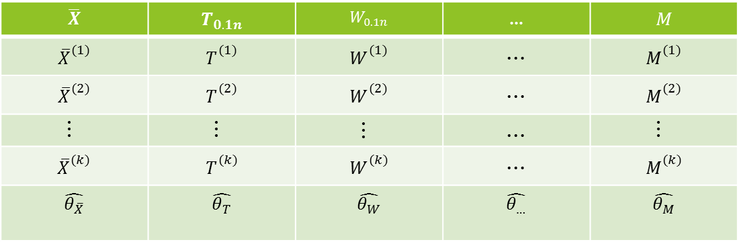
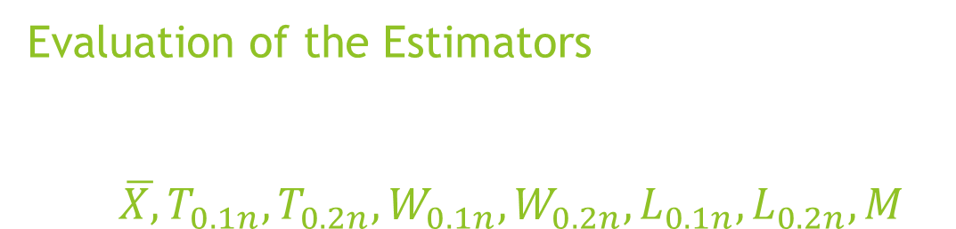
Evaluation of the Estimators $\overline{X,}T_{0.1n},T_{0.2n},W_{0.1n},W_{0.2n},L_{0.1n},L_{0.2n},M_{}$
$$\overline{X}$$ | $$T_{0.1n}$$ | $$W_{0.1n}$$ | … | $$M$$
$${\overline{X}}_{}^{(1)}$$ | $$T_{}^{(1)}$$ | $$W_{}^{(1)}$$ | ... | $$M_{}^{(1)}$$
$${\overline{X}}_{}^{(2)}$$ | $$T_{}^{(2)}$$ | $$W_{}^{(2)}$$ | ... | $$M_{}^{(2)}$$
... | ... | ... | ... | ...
$${\overline{X}}_{}^{(k)}$$ | $$T_{}^{(k)}$$ | $$W_{}^{(k)}$$ | ... | $$M_{}^{(k)}$$
$$\hat{θ_{\overline{X}}}$$ | $$\hat{θ_{T}}$$ | $$\hat{θ_{W}}$$ | $$\hat{θ_{…}}$$ | $$\hat{θ_{M}}$$

Slide 19

Evaluation of the Estimators
$\hat{Bias}\hat{(θ)}$ = $\frac{1}{k}\sum_{i=1}^{k}{\hat{θ}}$^{(i)}
$\hat{Var}\hat{(θ)}= \frac{1}{k}(\sum_{i=1}^{k}{\hat{θ}}$^{(i)} $\hat{−Bias}\hat{(θ)})$
$\hat{MSE}\hat{(θ)}= \hat{Var}\hat{(θ)}+\hat{Bias}\hat{(θ)}2$

Slide 20
General Results
Model | Bias | Variance | MSE
Normal – Model 1 | No pattern | Mean | Mean
Random – Model 2 | No pattern | T.1N | T.1N
Random – Model 3 | No pattern | T.1N | T.1N
Fixed – Model 4 | No pattern | No pattern | No pattern
Fixed – Model 5 | No pattern | No pattern | No pattern
Logistic – Model 6 | No pattern | T.1N | T.1N
Laplace – Model 7 | No pattern | T.1N | T.1N

Slide 21
General Results – Bias Examples

Slide 22
Normal (0,1)
Methods | Best Estimator
Bias | No Pattern
Variance | Mean
MSE | Mean
Sample Size | Best Estimator (Bias)
10 | Median
20 | W.1N
30 | Mean
40 | W.2N
50 | T.1N
* Using absolute value to compare

Slide 23
Random Outlier Model
0.9 N(0,1) + 0.1 N(0,4)
0.8 N(0,1) + 0.2 N(0,4)
Methods | Best Estimator
Bias | No Pattern
Variance | T.1N
MSE | T.1N
Methods | Best Estimator
Bias | No Pattern
Variance | T.1N
MSE | T.1N

Slide 24
Random Outlier Model
0.9 N(0,1) + 0.1 N(0,4)
0.8 N(0,1) + 0.2 N(0,4)
Sample Size | Best Estimator (Bias)
10 | Median
20 | Median
30 | Median
40 | Mean
50 | Mean
Sample Size | Best Estimator (Bias)
10 | Median
20 | Median
30 | L.2N
40 | Mean
50 | Median

Slide 25
Fixed Outlier Model
(n-1) N(0,1) and 1 N(0,4)
(n-2) N(0,1) and 2 N(0,4)
Methods | Best Estimator
Bias/Variance/MSE | No Pattern
Methods | Best Estimator
Bias/Variance/MSE | No Pattern
Size | Var | Bias | MSE
10 | T.1N | Mean | T.1N
20 | W.1N | W.1N | W.1N
30 | W.1N | Mean | W.1N
40 | Mean | T.1N | Mean
50 | Mean | W.2N | Mean
Size | Var | Bias | MSE
10 | T.1N | L.2N | T.1N
20 | T.1N | W.2N | T.1N
30 | W.1N | W.2N | W.1N
40 | W.1N | Mean | W.1N
50 | W.1N | W.1N | W.1N

Slide 26
Non Normal Distributions
Logistic Distribution
Laplace
Methods | Best Estimator
Bias | No Pattern
Variance | T.1N
MSE | T.1N
Methods | Best Estimator
Bias | No Pattern
Variance | T.1N
MSE | T.1N
Sample Size | Best Estimator (BIAS)
10 | Median
20 | Median
30 | L.2N
40 | W.2N
50 | L.2N
Sample Size | Best Estimator (BIAS)
10 | W.2N
20 | Median
30 | Mean
40 | Mean
50 | Median

Slide 27
Conclusion
No Pattern to Bias;
Fixed vs Random outliers;
Best estimator (Var/MSE);
Sample size issue.
Model | Bias | Variance | MSE
Normal – Model 1 | No pattern | Mean | Mean
Random – Model 2 | No pattern | T.1N | T.1N
Random – Model 3 | No pattern | T.1N | T.1N
Fixed – Model 4 | No pattern | No pattern | No pattern
Fixed – Model 5 | No pattern | No pattern | No pattern
Logistic – Model 6 | No pattern | T.1N | T.1N
Laplace – Model 7 | No pattern | T.1N | T.1N

